Slide 1
Some Social Security Basics:
Disability, Benefit Levels, Financial Status, Recent Proposals
Steve Goss and Karen Glenn
Office of the Chief Actuary
Social Security Administration
National Academy of Social Insurance
March 5, 2019

Slide 2
Social Security Disability Benefits
155 million workers under age 66 are insured against becoming unable to work
8.7 million workers now receive DI benefits
  1.7 million “dependents” – mostly children
Many more protected from loss of insured status
  And from lower retirement benefits
In addition:
  1 million disabled adult child beneficiaries
  0.3 million disabled widow(er) beneficiaries
2

Slide 3
Social Security Disability Benefits
Requires inability to “engage in any substantial gainful activity (SGA) due to medically determinable impairment
May be determined disabled if have “severe” impairments, meeting or equaling specific medical “listings”
Or if, in addition to a severe impairment, there are substantial functional limitations considering age, education, and past work
Beneficiaries are monitored for medical improvement by “diaries” with periodic Continuing Medical Reviews
Beneficiaries are encouraged to return to work which can cease benefits
3

Slide 4
Recent Favorable Disability Experience
Applications and incidence are at historic low levels
Numbers of beneficiaries have been declining since 2013
Prevalence rates have peaked and are dropping
What about the future?
  Are declines temporary, or the new state?
  Possibilities:
    Economy and jobs—temporary
    Drop in hearings allowance rates—temporary?
    Increased health care (ACA)
    Field office consolidations
    Attorney representation
    Something more fundamental?
4

Slide 5
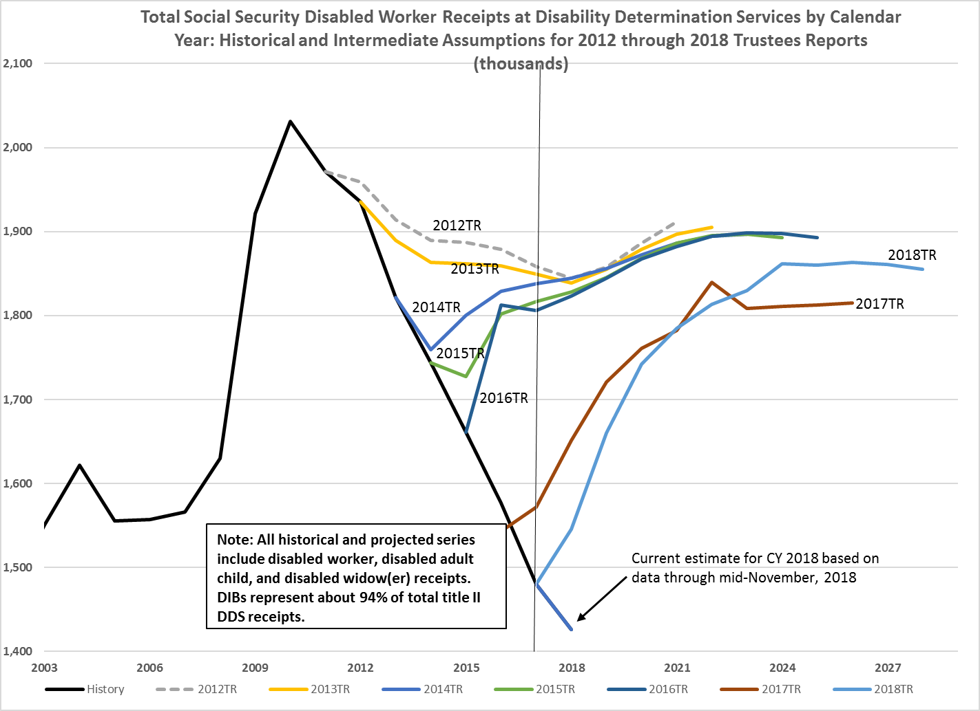
Applications Are Still Dropping in 2018!
5

Slide 6
  Disability Incidence Rate Falls to Historic Lows
        DI disabled worker incidence rate rose sharply in the recession, and has declined since the peak in 2010 to extraordinarily low levels for 2016 through 2018

Slide 7
Fewer Disabled Worker Beneficiaries
Fewer now and in near term based on recent applications and incidence rates
7

Slide 8
DIBs awarded through June 2018 by year of entitlement and primary diagnosis code, males age 30-39 at entitlement

Slide 9
DIBs awarded through June 2018 by year of entitlement and primary diagnosis code, males age 50-59 at entitlement

Slide 10
Social Security Monthly Benefit Levels
Primary Insurance Amount (PIA) is a progressive formula replacing a portion of worker’s career-average past earnings level (highest 35 years of earnings–indexed to average wage–for retirees)
Benefits replace 40% to 45% of career earnings, on average
  About 80% for very-low earner, about 28% for steady maximum earner
Auxiliary beneficiaries (family members) may receive half of the PIA of the retired or disabled worker
  Surviving spouses may receive 100 percent; other survivors 75 percent
Total benefits payable on a worker’s account limited to “family max”
Retired-worker and spouse benefits are modified by age at start of receipt
10

Slide 11
Replacement Rates Based on the 2018 TR
Source: Annual Recurring Actuarial Note #9 at www.ssa.gov/oact/NOTES/ran9/index.html

Slide 12
How About at Age 62, Where Many Start Benefits?
Source: Annual Recurring Actuarial Note #9 at www.ssa.gov/oact/NOTES/ran9/index.html

Slide 13
Payable Benefits Under the Law, After Trust
Fund Reserves Are Depleted, Are Even Lower
Source: Annual Recurring Actuarial Note #9 at www.ssa.gov/oact/NOTES/ran9/index.html

Slide 14
Social Security Monthly Benefit Levels
Monthly benefit level after initial eligibility increases with COLA
  Based on CPI-W (urban wage earners)
  Thus, while individuals’ benefits keep up with price levels, they fall behind average earnings levels
Benefit levels from one generation to the next rise with average earnings
But the “special minimum” benefit has been only CPI-indexed
  So now applies to virtually no beneficiaries
Monthly benefit levels may be offset by WEP, GPO, and workers comp
  Disability benefits may be suspended or ceased due to earnings
  Other benefits (under the Normal Retirement Age) may be deferred by earnings test
14

Slide 15
  SOLVENCY: OASDI Trust Fund Reserve Depletion in 2034
  Reserve depletion date varied from 2029 to 2042 in reports over the past 26 years (1992-2018)
15

Slide 16
Changing Age Distribution Over Last 20 and Next 20 Years Largely Explain the Financial Status of the OASI and DI Trust Funds
Notes:
Alternative chart format

Slide 17
OASDI Annual Cost and Non-Interest Income as Percent of Taxable Payroll
Persistent Negative Annual Cash-Flow Balance Starting in 2010
79% of scheduled benefits still payable at trust fund reserve depletion
Annual deficit in 2092: 4.32 percent of payroll
17

Slide 18
SUSTAINABILITY: Cost as Percent of GDP
Rises from a 4.2-percent average in 1990-2008, to about 6.1% by 2038, then declines to 5.9% by 2052, and generally increases to 6.1% by 2092
18

Slide 19
The Bottom Line
Long-term projections provide information to assess solvency and changes needed to eliminate shortfalls
If trust fund reserves were to deplete:
  Full benefits cannot be paid on time—no borrowing authority
  So Congress must act, as it always has
Straightforward solutions:
  Add revenue and/or lower cost for OASDI
  Comprehensive changes implemented by 2034

Slide 20
How to Fix Social Security Long-Term
Make choices addressing OASDI deficits 2034-2092:
  Raise scheduled revenue after 2033 by about one-third
  Reduce scheduled benefits after 2033 by about one-fourth
  Or some combination of the two
  Invest trust funds for higher return?
      Limited help—it is a PAYGO world
      So invest in coming generations of workers

Slide 21
Ways to Lower Cost
Lower benefits for retirees—not disabled?
  Increase normal retirement age (lowers OASDI cost, but increases DI cost)
  Can exempt long-career low earners
Lower benefits mainly for high earners?
  Reduce PIA above some level
  Often combined with increasing PIA below some level, subject to work year requirements
Lower benefits mainly for the oldest old?
  Reduce the COLA: chained CPI?
  But, some say increase it with the CPI-E (based on purchases of consumers over age 62)

Slide 22
Ways to Increase Revenue
Raise the 12.4 percent OASDI payroll tax rate?
Raise tax on highest earners?
  Increase taxable maximum amount
  Some tax on all earnings above the maximum
Tax employer group health insurance premiums?
  Affects only middle class if taxable maximum remains
  Tax investment income?

Slide 23
Examples of Comprehensive Proposals
Larson, Blumenthal, Van Hollen—introduced in January 2019
  Increase revenue to cover shortfall, and increase some benefits
Johnson—introduced in December 2016
  Largely reduce scheduled benefits, but eliminate taxation of benefits and add minimum benefits
Simpson-Bowles Commission—plan released in December 2010, but not introduced
  A mix of additional revenue and reduced benefits

Slide 24
Representative John Larson (D-CT) et al, January 2019
Make PIA formula slightly more generous, more “progressive” (shortfall ↑8%)
Increase the COLA (↑14%)
  Based on CPI-E for all beneficiaries; 0.2pp higher on average
  Index designed to better reflect the purchases of the elderly
Improve the minimum benefit (↑4%)
Lower taxation of OASDI benefits slightly (↑6%)
Tax earnings above $400K (not indexed) with small benefit credit (↓67%)
Increase payroll tax rate gradually from 12.4 percent to 14.8 percent (↓64%)
Would produce “sustainable solvency” (shortfall ↓109%)
See: https://www.ssa.gov/OACT/solvency/LarsonBlumenthalVanHollen_20190130.pdf

Slide 25
Representative Sam Johnson (R-TX), December 2016
Make PIA formula less generous but more “progressive” (shortfall ↓32%)
Change to mini-PIA approach (↓13%)
Raise the Normal Retirement Age gradually (↓32%)
Lower the COLA (↓47%)
  Based on chain-weighted CPI for most beneficiaries; 0.3pp lower on average
  No COLA if prior year’s MAGI is above certain thresholds
Add a new minimum benefit (↑9%)
Eliminate taxation of OASDI benefits in 2054 and later (↑15%)
Would produce “sustainable solvency” (shortfall ↓100%)
See: https://www.ssa.gov/OACT/solvency/SJohnson_20161208.pdf

Slide 26
Simpson-Bowles Commission, December 2010
Index NRA to keep ratio of retirement years to work years constant, with exemption for long-career low earners (shortfall ↓18%)
Make PIA formula less generous but more “progressive” (shortfall ↓45%)
Lower the COLA (↓26%)
  Based on chain-weighted CPI; 0.3pp lower on average
Improve the minimum benefit (↑8%)
Increase benefits 5 percent for older retirees (↑8%)
Increase taxable maximum to cover 90 percent of earnings (↓ 35%)
Cover newly hired state and local gov’t employees (↓ 8%)
Would produce “sustainable solvency” (shortfall ↓112%)
See: https://www.ssa.gov/OACT/solvency/FiscalCommission_20101201.pdf

