Slide 1
Health Disparities & Equity in a Medicare Expanded World
Prof. Gwendolyn Roberts Majette, J.D., LL.M.
Cleveland-Marshall College of Law
Center for Health Law and Policy
g.majette@csuohio.edu
March 5, 2020

Slide 2
PROGRESS – US Efforts to Improve the Health of People of Color
Medicare & Medicaid (1964)
Title VI of the 1964 Civil Rights Act
Report of the Secretary’s Task Force on Black and Minority Health (Heckler Report)(1985)

Slide 3
PROGRESS – US Efforts to Improve the Health of People of Color
Presidential Initiative to Eliminate Racial and Ethnic Disparities in Health (1998)
Congressional Funding for an IOM study --reporting on the Prevalence & Impact of Racial and Ethnic Bias (1999)
IOM Report Unequal Treatment: Confronting Racial and Ethnic Disparities in Health Care (2003)
PPACA (ACA) 2010

Slide 4
Notes:
-

Slide 5
Global Health Laws that impose a duty on the US to reduce/eliminate health disparities
Binding Global Health Laws
Global Health Governance – WHO Policies
Commission on Social Determinants of Health
Rio Political Declaration
International Convention on the Elimination of All Forms of Racial Discrimination
Aspirational Global Health Laws
International Covenant on Economic, Social & Cultural Rights
Gen Cmt 14
Reports of the Special Rapporteur for Health
Lancet Report on Right to Health Indicators

Slide 6
Global Health Governance - Commission on Social Determinants of Health
3 Recommendations
Improve Daily Living Conditions
Universal Health Care System
Tackle Inequitable Distribution of Power, Money & Resources
Health Equity in ALL Policies, Systems & Programs
Measure & Understand the Problem & Assess the Impact of Action
Health Equity Surveillance

Slide 7
Factors to Strengthen the HC System to protect the Right to Health and Eliminate Health Disparities
UN Special Rapporteur for Health 2008 Report
Factors impacting Health Disparities
Factor 5 - Equity, Equality, Non-Discrimination
Factor 7 - Medical Care + Underlying Determinants
Factor 10 - Quality

Slide 8
Factor 5 - Equity, Equality, Non-discrimination
Health Equity means “eliminating disparities in health and in health’s major determinants that are systematically associated with underlying social disadvantage within society.” (WHO)

Slide 9
Factor 5 - Equity, Equality, Non-discrimination
EQUITY - Providing health care to ALL individuals in a manner that does NOT vary in quality because of personal characteristics such as gender, ethnicity, …and socioeconomic status. (IOM)
EQUITY – A CORE Aspect Of QUALITY

Slide 10
Title VI of the 1964 Civil Rights Act Non-Discrimination
Prohibits discrimination on the basis of race, color, and national origin in programs and activities that receive federal financial assistance

Slide 11
GHL - Non-Discrimination
Racial Discrimination – any distinction, exclusion, restriction, or preference based on prohibited grounds (race, colour, descent, national or ethnic origin) with the INTENT or EFFECT of impairing enjoyment of a covenant right. (ICERD art. 1)
ICESCR – the parties agree to guarantee that the rights to this treaty will be provided without discrimination of any kind as to race, colour, .. language … or other status (ICESCR art. 2)

Slide 12
GHL - Equality
Positive Equality
Treat everyone the same unless Explicit justification to the contrary

Slide 13
Factor 10 – Quality
GOOD QUALITY = Health Care Services, Goods & Facilities
POLITE & RESPECTFUL = Treatment by HC workers

Slide 14
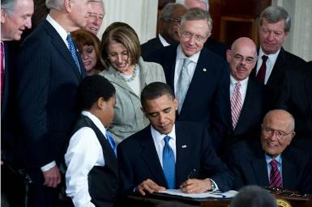
Creating a Legislative Framework to Protect the Right To Health
National Strategy = Ensures that Everyone has access to health care facilities, goods & services
Framework Law = Implementation of the national strategy

Slide 15
PPACA – Framework Legislation to Eliminate HC Disparities
Health & Health INEQUITY is a priority at the Highest Level of Govt
Govt Policy regarding the HEALTH Sector includes Health Disparities & SDH
Multi-Sectoral Approach to Health
HEALTH-IN-ALL Policies

Slide 16
PPACA – Framework Legislation to Eliminate HC Disparities
PRIORITY ISSUE – Universal Coverage
PPACA
Exchange
IR Market Reforms
Medicaid Expansion
Monitor SDH & Health Inequity
PPACA complies w/ RTH Indicators
PPACA Sec. 1557
National Health Care Workforce Commission
Commission on Key National Indicators

Slide 17
Global Health Law Norms & US Responsibility to Eliminate HD (2012 & 2014)
ICERD ICESCR
Special Rapporteur for Health – features of a HC System that protects the RTH Equity, Equality & Non-Discrimination QUALITY Medical Care & Underlying Determinants
Commission on Social Determinants of Health “Closing the Gap in a Generation”
PPACA FRAMEWORK TO ELIMINATE HEALTH DISPARITIES
Gwendolyn Roberts Majette, Global Health Law Norms and the PPACA Framework to Eliminate Health Disparities, 55 How. L. J. 887 (2012); Gwendolyn Roberts Majette, Global Health Law Norms: A Coherent Framework to Understand PPACA’s Approach to Eliminate Health Disparities and Address Implementation Challenges, in Law and Global Health: Current Legal Issues (Oxford University Press 2014).

Slide 18
NQF – Framework to Achieve Health Equity & Eliminate Disparities

Slide 19
NQF – Domains of Health Equity Measurement (9/2017)

Slide 20
America’s Unjust Health Care System

Slide 21
Adults ages 18-64 who were uninsured at the time of interview, by race/ethnicity, 2010-2018
Source: National Center for Health Statistics, National Health Interview Survey Early Release Program, May 2019. https://www.cdc.gov/nchs/data/nhis/earlyrelease/insur201905.pdf.
Note: For this measure, lower rates are better. White, Black, and Asian are non-Hispanic. Hispanic includes all races. Data for Native Hawaiians/Pacific Islanders and American Indians and Alaska Natives are not available for this measure.

Slide 22
Legal Retrenchment
Notes:
Gwendolyn Roberts Majette, Striving for the Mountaintop: The Elimination of Healthcare Disparities in a Time of Retrenchment (1968 – 2018), Geo. J. L. & Mod. Crit. Race Persp. (forthcoming 2020)(analyzing the effectiveness of the PPACA Framework to Eliminate Health Disparities and business and human rights norms that can be used to encourage the United States and the health care industry to continue to reduce health care disparities).

Slide 23
Status of State Medicaid Expansion Decisions
ME
WA
VT
MT
ND
MN
NH
OR
MA
WI
NY
ID
SD
MI
RI
WY
CT
IA
PA
NJ
NE ◊
OH
DE
NV
IL
IN
MD
UT
CO
WV
VA
CA
KS
MO
KY
DC
NC
TN
AZ
OK
AR
SC
NM
MS
AL
GA
Adopted (37 States including DC)
TX
LA
AK
Not Adopting At This Time (14 States)
FL
HI
NOTES: Current status for each state is based on KFF tracking and analysis of state activity. ◊Expansion is adopted but not yet implemented in NE. (See link below for additional state-specific notes).
SOURCE: “Status of State Action on the Medicaid Expansion Decision,” KFF State Health Facts, updated February 19, 2020. https://www.kff.org/health-reform/state-indicator/state-activity-around-expanding-medicaid-under-the-affordable-care-act/

Slide 24
Blacks make up a greater share of the population in the South, where most states have not expanded Medicaid.
SHARE OF TOTAL POPULATION THAT IS BLACK BY STATE, 2017
<5% (19 States)
5%-15% (21 States)
>15% (10 States + DC)
14 States with No
Medicaid Expansion
Note: Blacks are non-Hispanic and exclude individuals of mixed race. States outlined in black have not adopted Medicaid expansion as of May 2019.
Source: Kaiser Family Foundation analysis of 2017 American Community Survey, 1-Year Estimates and Kaiser Family Foundation, Status of State Action on the Medicaid Expansion Decision, as of April 26, 2019, https://www.kff.org/health-reform/state-indicator/state-activity-around-expanding-medicaid-under-the-affordable-care-act/.

Slide 25
American Indian/Alaska Natives have Gained Coverage Under the Affordable Care Act, with Larger Increases in States that Expanded Medicaid.
HEALTH INSURANCE COVERAGE FOR NONELDERLY AIANs BY EXPANSION STATUS, 2013 & 2017
2013
2017
2013
2017
Expansion States
Non-Expansion States
Note: AIANs are non-Hispanic. Excludes individuals of mixed race. Includes nonelderly individuals 0-64 years of age.
Source: Kaiser Family Foundation analysis of the 2013 & 2017 American Community Survey (ACS), 1-Year Estimates.

Slide 26
Hispanics face greater barriers to accessing care and receive less care than Whites.
Note: ^ Indicates in the past 12 months. Persons of Hispanic origin may be of any race; Whites are non-Hispanic and exclude individuals of mixed race. Includes nonelderly individuals 18-64 years of age. Data for uninsured includes nonelderly adults 19-64 years of age. All values have a statistically significant difference from the White population at the p<0.05 level.
Source: Kaiser Family Foundation analysis of 2017 American Community Survey (ACS), 2017 National Health Interview Survey (NHIS), and 2017 Behavioral Risk Factor Surveillance System (BRFSS).

Slide 27
American Indian-Alaska Natives (AIAN) fare worse than Whites across many health measures.
* Indicates statistically significant difference from the White population at the p<0.05 level.
Note: AIANs and Whites are non-Hispanic. Excludes individuals of mixed race. Includes nonelderly adults 18-64 years of age.
Source: Kaiser Family Foundation analysis of 2017 National Health Interview Survey (NHIS), 2017 Behavioral Risk Factor Surveillance System (BRFSS), and 2017 National Survey on Drug Use and Health.

Slide 28
Native Hawaiian and Other Pacific Islanders (NHOPI) fare worse than Whites on many health measures. Asians often fare better than Whites, but…
* Indicates statistically significant difference from the White population at the p<0.05 level.
Note: Includes nonelderly individuals 18-64 years of age, unless otherwise noted. All racial groups are non-Hispanic and exclude individuals of mixed race. N/A: Estimate does not meet minimum standards for statistical reliability.
Source: Kaiser Family Foundation analysis of 2014 National Health Interview Survey (NHIS) and 2016 Behavioral Risk Factor Surveillance System (BRFSS). NHOPI values for Fair/Poor Health Status, Ever Had Asthma, and Problems Paying Medical Bills come from the 2014 NHPI NHIS.

Slide 29
Number & percentage of QUALITY measures for which Blacks experienced better, same, or worse quality of care compared with reference group (White), 2013, 2015, 2016, or 2017
Key: n = number of measures.
Note: The most recent data years are used for this analysis. Different data sources have different data years for most recent data year. For example, the most recent data year from NIDDK USRDS is 2013 and from AHRQ HCUP is 2016.

Slide 30
Medicare Expansion: A Step Forward
The Walking Man – Auguste Rodin
Notes:
Rodin’s Walking Man statute

Slide 31
MEDICARE EXPANSION Patient – Insured Benefit
Access to care
Improved health status
Financial wellbeing

Slide 32
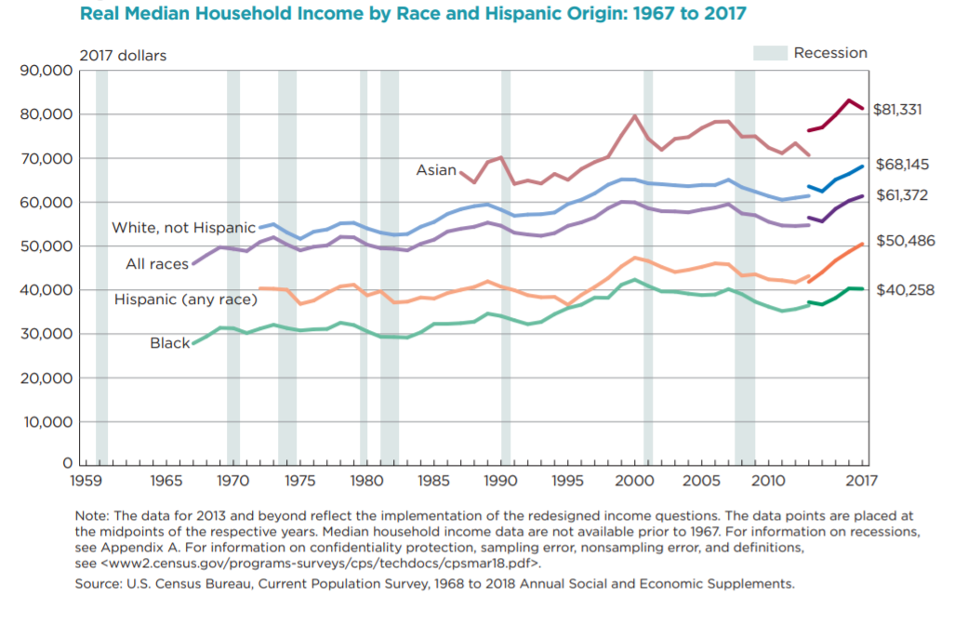
How Will Medicare Expansion Reduce HealthCare Inequality?
In the United States, people of color have an
an average median income that is lower
than whites.
As the costs of healthcare
continue to increase, including
out-of-pocket costs for insurance, the
difference in income inequality affects the
ability of people of color to access healthcare.
Real Median Household Income by race and Hispanic Origin: 1967 to 2017
Census.gov/dam/census/library/p60263

Slide 33
MEDICARE EXPANSION Provider Benefit
Reimbursement – Financial stability/profitability
Providers that traditionally cared for large numbers of Medicaid, Medicare, and uninsured patients
Wage Increase & Additional training
Low-wage health care workers

Slide 34
Seminal Question – Does the Medicare expansion plan create a system that reduces health care disparities and promotes equity?

Slide 35
The END
QUESTIONS & COMMENTS

